Slide 1
Planning for a
Grid in Transition
Rich Dewey
President & CEO
Climate Action Council
October 8, 2020

Slide 2

Our mission, in collaboration with our stakeholders, is to serve the public interest and provide benefit to consumers by:
  Maintaining and enhancing regional reliability
  Operating open, fair and competitive
  wholesale electricity markets
  Planning the power system for the future
  Providing factual information to
  policymakers, stakeholders and investors
  in the power system

Slide 3
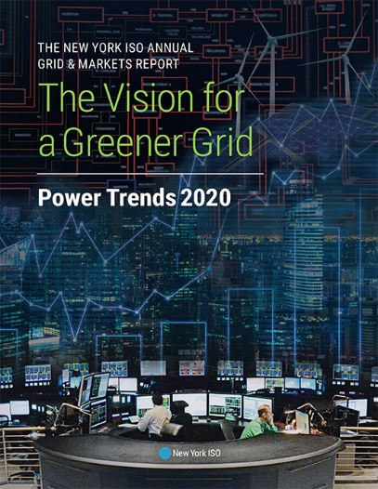
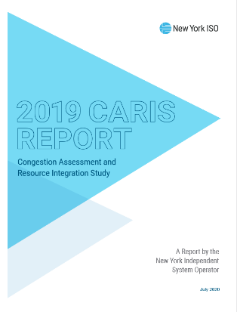
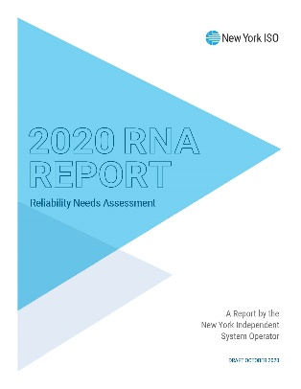
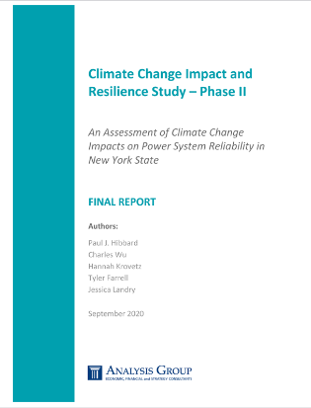
The Vision for a Greener Grid
Delivering on our mission: the Grid is the platform for success of the CLCPA.
We believe State policy goals can be achieved while maintaining grid reliability.
In support of the CLCPA objectives, we are hard at work identifying future needs of the system.
The NYISO is conducting studies to plot the most productive way forward while maintaining reliability and keeping costs low for consumer during this difficult time.
  Congestion
  Assessment
  and Resource Integration Study (CARIS):
  includes a scenario
  analyzing the
  CLCPA’s 70X30 goal:
  Reliability Needs Assessment (RNA)
  examines the
  DEC rules on
  emissions
  from generators
  used to serve
  peak load;
  The NYISO
  has also
  undertaken a
  Climate Change
  Impact &
  Resilience
  Study

Slide 4
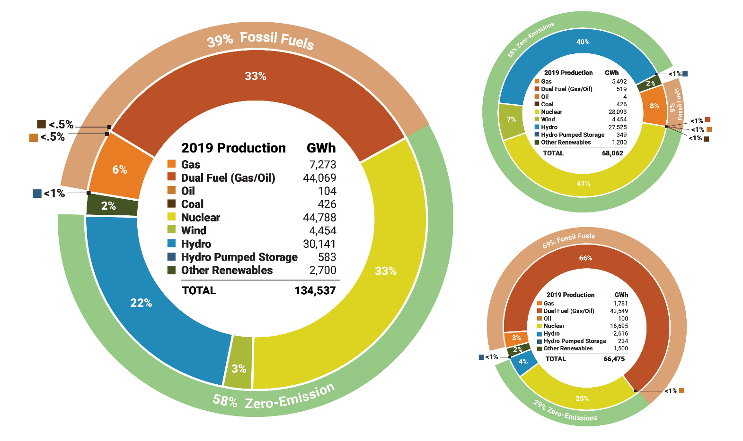
New York 2019 Energy Production
New York
Statewide
Energy
Production
by Fuel
Source:
2019
Upstate (Zones A-E)
Energy Production by Fuel Source: 2019
Downstate (Zones F-K) Energy Production by Fuel Source: 2019
Notes:
Fossil fuel-fired generation accounts for 66% of NY’s generating capacity, but only 39% of its energy production
Nuclear resources account for 14% of the state’s generating capacity, but contribute to 32% of the total energy produced
Hydropower accounts for 11% of the state’s generating capacity, but contributes 21% of total energy produced

Slide 5
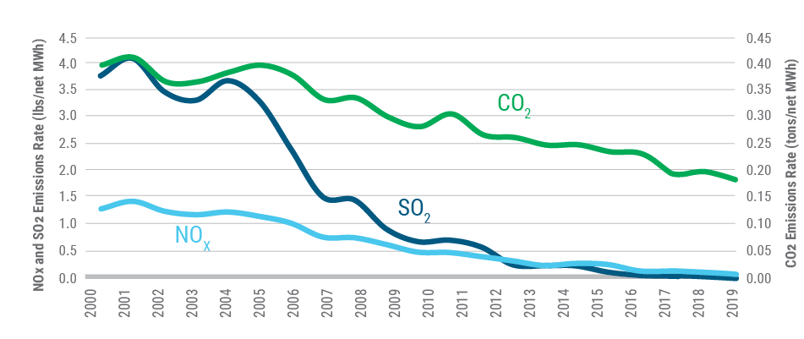
Cleaner Generation but Much More To Do
Emissions Rates from Electric Generation in New York: 2000-2019
From 2000
through 2019, emission
rates of:
Sulfur dioxide
(SO2) dropped 99%
Nitrogen oxides (NOX) dropped 92%
Carbon dioxide (CO2) dropped 55%
Notes:
NYISO markets provide price signals to encourage generators to operate more efficiently, supporting public policy goals of reducing emissions

Slide 6
A Grid in Transition – Path Forward
The NYISO’s wholesale markets can serve as an effective platform for achieving New York State environmental objectives.
  Through active engagement with stakeholders and policymakers, the NYISO is developing design improvements to meet the future challenges expected to arise with high levels of intermittent renewable and distributed energy resources.
The plan includes a set of market design enhancements that work together coherently and efficiently to satisfy New York’s changing grid reliability needs.
  Nine areas of market design opportunities across three main points of focus require immediate attention and are recommended for implementation in the next five years, through 2024.
NYISO’s Wholesale Market Platform
Maintaining Grid Reliability
Enabling Climate Policy
Lowering Costs

Slide 7
Grid in Transition
Demand Trends

Slide 8
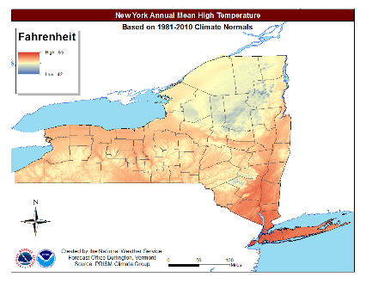
Climate Change Study – Phase 1
Evaluate temperature trends and state climate impact studies
Develop long-term energy, peak, and hourly load shapes that reflect the potential impact of climate change
Construct additional forecast scenarios that
reflect state policy goals and include climate
change impacts
Develop long range models to incorporate into future studies

Slide 9
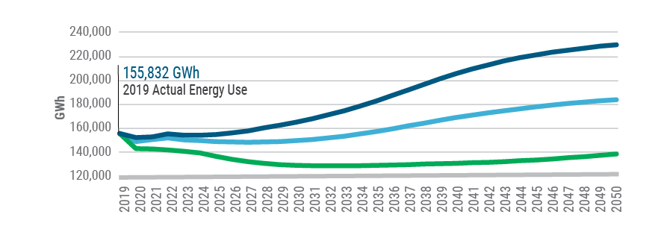
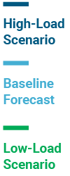
Demand Trends
2019-2050 Forecast
Electric Energy Usage Trends and Forecast in New York State: 2019-2050
Notes:
NYISO lowered forecast for 2020 and 2021 due to expected impacts on load associated with COVID-19 response and recovery
The Baseline Forecast shows the expected statewide loads under expected economic and weather conditions, and accounts for the load-reducing impacts of energy efficiency programs, behind-the-meter (BTM) solar and other distributed generation, building codes, and efficiency standards. The Baseline Forecast also includes the expected impacts of electric vehicle (EV) usage and other electrification measures.
The Low-Load Scenario assumes increased adoption of energy efficiency, BTM solar, and fewer purchases of EVs and other electrification measures.
The High-Load Scenario assumes reduced adoption of efficiency and solar, but increased electrification measures. These Low and High scenarios provide bounds around the level of uncertainty in forecasting future energy usage.

Slide 10
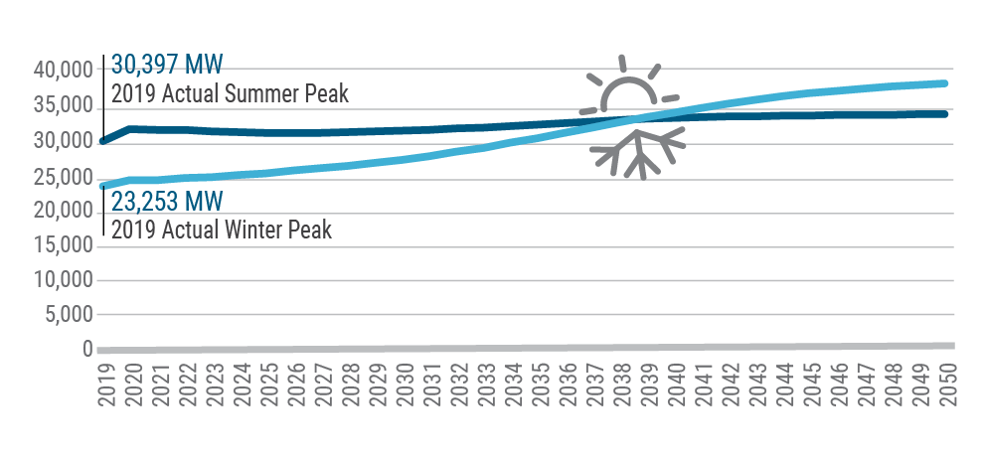
Electrification Policies & the Grid
The NYISO leveraged assumptions from its climate change study about electrification to inform its 2020 Gold Book winter and summer
peak load forecasts.
Notably, the NYISO’s forecasts suggest that the impacts of EVs and increased reliance on electricity for heating will lead to the system peak shifting from summer to winter as early as 2039.
2020 Gold Book Baseline Summer and Winter Peak Forecasts

Slide 11
Current System Reliability Needs
Deficiencies in reliable system performance are currently projected during the 2023 - 2030 time period.
These deficiencies (primarily in the New York City area) are primarily driven by expected reductions in available generation capacity to comply with NOx emission regulations.
The magnitude and nature of the deficiencies are driven by the ten-year load forecast in combination with insufficient transmission or generation to serve the forecasted load.
The deficiencies can potentially be addressed by combinations of solutions including generation, transmission, and load reduction measures (energy efficiency, demand response, etc.)
The NYISO continues to reassess the load forecast in light of COVID-19 and the associated evolving impacts to the economy and demand on the electric grid.

Slide 12
Grid in Transition
Transmission

Slide 13
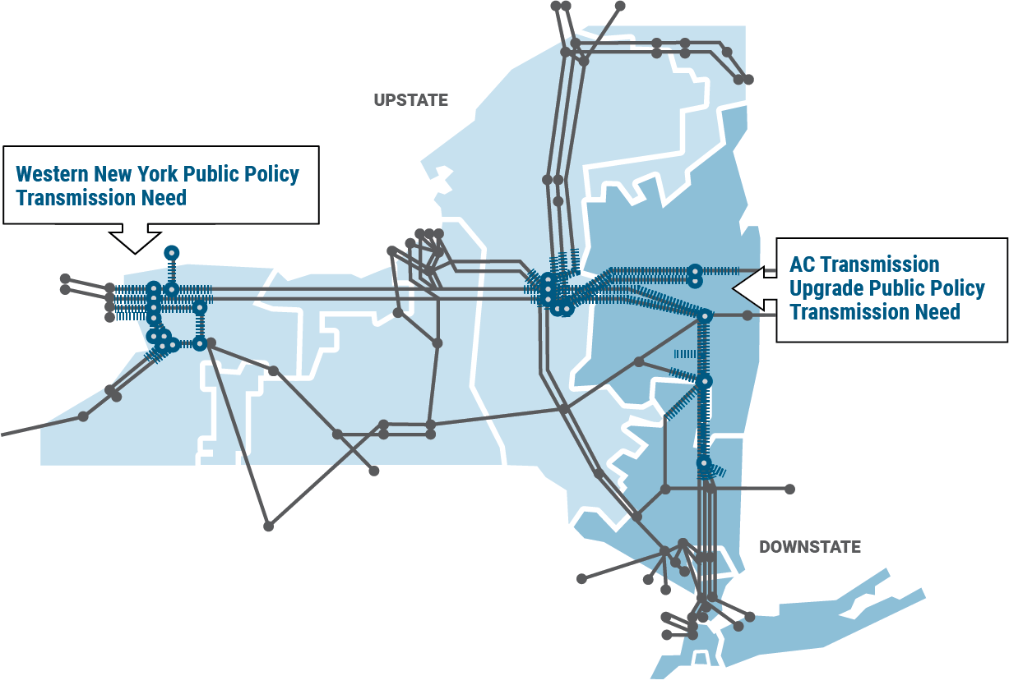
Public Policy Transmission
Most Significant Investment in Decades:
Increase flow of hydro and imports from Ontario from Western NY to the eastern NY
Increase flow from upstate to downstate by ~1,000 MW
Notes:
WNY Transmission Project
Transmission constraints affect Niagara generation and Ontario imports
In October 2017, the NYISO Board selected the NextEra project to meet this need with an in-service date of June 2022
NextEra is actively seeking permits for construction
AC Transmission Upgrades
PSC sought to increase transfer capability from central to eastern NY by at least 350 MW, as well as from the Albany region through the Hudson Valley region by at least 900 MW
In 2019, the NYISO Board selected North American Transmission and the New York Power Authority to meet the need identified in Segment A, and selected National Grid and New York Transco to meet the need identified in Segment B
Both segments are actively seeking permits for construction
Both projects are expected to enter into service in December 2023

Slide 14
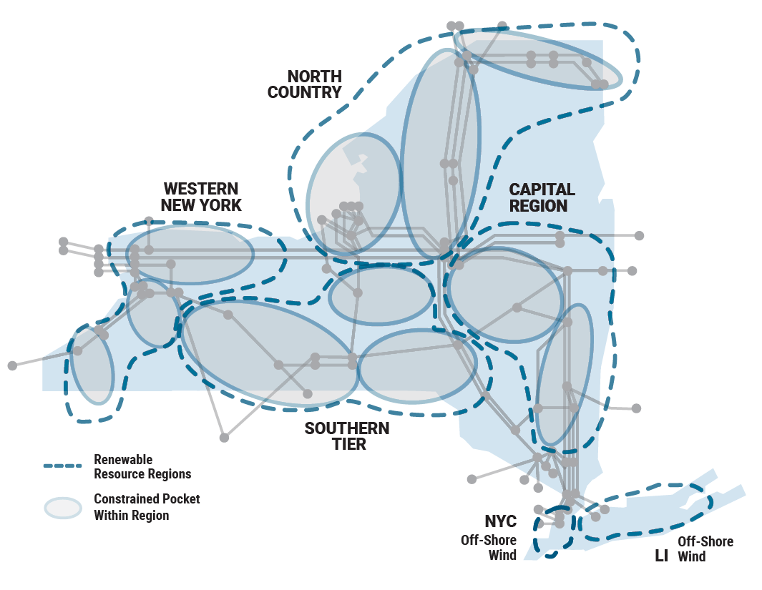
Renewable Generation
Pockets
Transmission constraints that may prevent renewable energy delivery.
Renewable generation would be curtailed due to insufficient bulk and local transmission capability to deliver the power.
Additional transmission expansion, at both bulk and local levels, will be necessary to efficiently deliver renewable power to New York consumers.
Notes:
The public policy process that this analysis supported is currently underway
The next step in the current cycle is a determination by the NY PSC that a public policy need exists for additional transmission to address the identified system constraints

Slide 15
Grid in Transition
Supply

Slide 16
Climate Change Study – Phase 2
Examines various generation scenarios that could meet policy objectives in 2040
Uses an hourly, deterministic evaluation tool for the purpose of considering various potential impacts on the electric grid
  Study examines whether the bulk power system is able to serve load and meet reserve requirements under a variety of conditions
Assesses the resiliency of the grid for climate events such as periods of extreme temperatures, wind lulls, and severe storms

Slide 17
Resource Mix by Seasonal Modeling Period
Generation by Resource Type – Summer 2040
CLCPA Load Scenario, Baseline Case
Generation by Resource Type – Winter 2040
CLCPA Load Scenario, Baseline Case

Slide 18
Dispatchable Energy Resources
Large quantity of installed dispatchable energy resources needed in a small number of hours
Dispatchable resources must be able to come on line quickly, and be flexible enough to meet rapid, steep ramping needs

Slide 19
Grid in Transition
Conclusions

Slide 20
Key Takeaways
The intermittency associated with wind and solar resources presents a fundamental challenge to relying on those resources to exclusively meet electricity demand.
Transmission investment, at both bulk and local levels, will be necessary to efficiently deliver renewable power to New York consumers.
The current system is heavily dependent on existing fossil-fueled resources to maintain reliability. Eliminating these resources will require investment in new and replacement infrastructure, and/or the emergence of a zero-carbon fuel source for thermal generating resources.
  Market solutions to drive investment
  Development of innovative new technologies
The dispatchable and emissions-free resources needed to balance the system must be significant in capacity, able to ramp quickly, and be flexible enough to meet rapid, steep ramping needs.
Battery storage resources help address variability from renewable resources, but based on current technology, periods of reduced renewable generation rapidly deplete battery storage resource capabilities.

Slide 21
Questions?

